Slide 1
Fluidic System V3.0

Slide 2
Goals
Drastically reduce stain volume needed
Increase repeatability
Increase channel capacity
Increase durability
Move liquid faster

Slide 3
Limitations of V2.0 system
Pinch valve requires large ID tubing, in and out of it. Most of my dead volume exists in this region
Open source FAST micro-peristaltic pump can occasionally break. Especially the drive axle.
No speed feedback. Valve to valve variability exists and everything needs calibrated with the assumption that it remains constant over time.
Minor point, sound is loud from pump
Pinch valve controller is internally damaged and can be occasionally unstable
The FAST pumps max pressure is well under what pressure the fluidic device can handle. I could easily double the speed. With a large drain port diameter, I could increase it even further.

Slide 4
Idealistic Fluidic System V3.0
Elve flow has idealistic products due to their open-source friendly nature.
No noise
>8 channels
Low transfer volumes
Easy to interact with

Slide 5
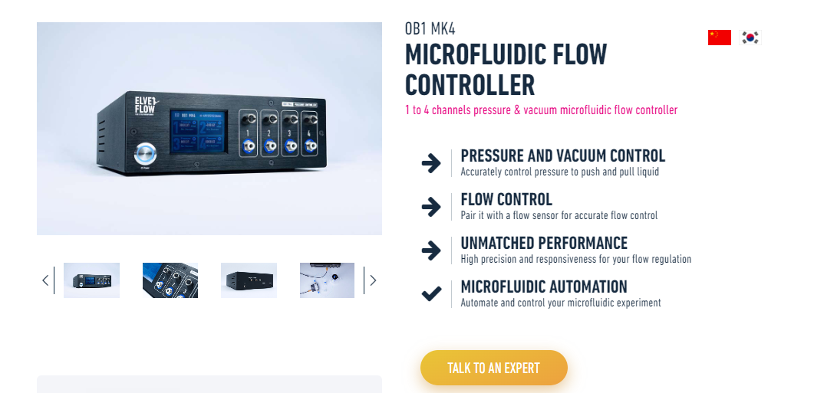
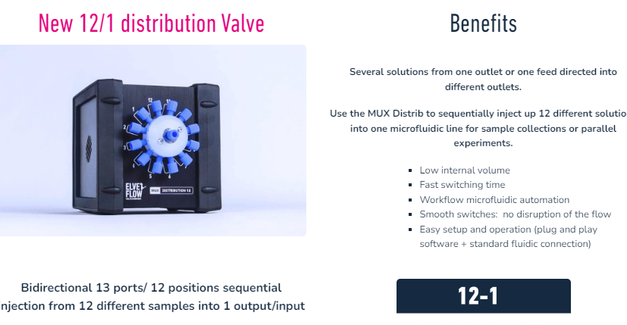
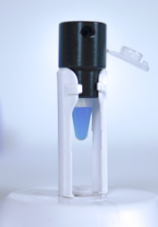
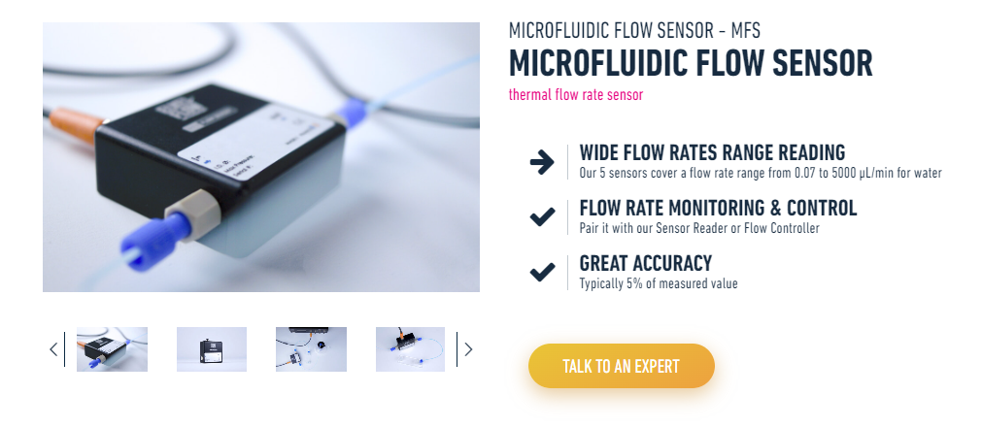
Elve Flow parts
UART communication system to interface with Arduino controller
12 valve system.
1 primary
1 secondary
1 dapi
1 blocking
1 bleach
1 PBS
6 direct conjugated channels
Flow rate feedback
Uses gas and vacuum lines for silent and constant operation
Tiny to large reserviors

